Slide 1
Creating GridLAB-D GLM files for analysis from current format

Slide 2
Basic Process
Convert CYMDIST/SynerGEE models to GLM (PERL)
Test powerflow only (static spot loads)
If Ps, Qs, and Vs match up over entire system move to next step, else look for errors in conversion
Populate GLM with loads (Matlab script)
Iterate to calibrate to SCADA
Populate GLM with additional technologies (Matlab script)
Analyze, analyze, analyze

Slide 3
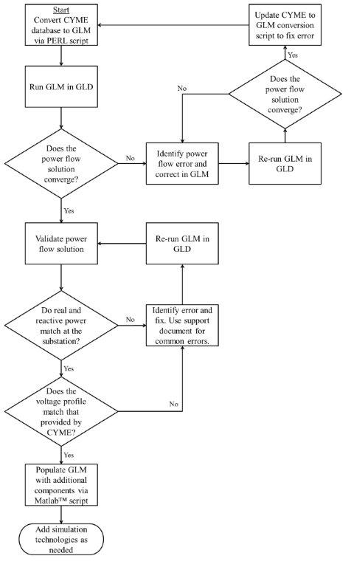
Basic Process

Slide 4
Installing and Using PERL Script

Slide 5
How do we use PERL?
Converts CYME databases to GLM files
Could be easily adapted to other input formats such as Windmil, OpenDSS, etc.
Places classification tags throughout file for future use
More on this later
Does an initial check for possible issues that would cause the system to not correctly solve (e.g. loops and islands)

Slide 6
Why PERL?
Scripting language for text processing
Highly flexible and adaptable
Works easily with database access
Open source interpreter software

Slide 7
Installing PERL
Go to:
http://www.activestate.com/activeperl/downloads
Download desired version & install
Has only been tested with 32-bit windows (64-bit doe not appear to work due to ODBC issues)
Created with 5.10, but seems to work with 5.12
After install, go to
Start->Programs->ActivePerl **->Perl Package Manager

Slide 8
Installing PERL (cont.)
Click “View All Packages”
Mark “Win32-ODBC”, “Math-Random”, & “Spreadsheet-ParseExcel” for install
View packages to install and install the packages

Slide 9
Running PERL Script
Include the input database files in your working directory
In command prompt, type:
C:\mydir perl Cyme_to_GridLabD.pl myfeeder_eq.mdb myfeeder_network.mdb mynewname
Note: You may run into ODBC permission problems – the working folder must have full read/write ODBC access

Slide 10
What does this get us?
An output GLM file called mynewname.glm
The output GLM contains
All information on primary side of residential transformers available in CYME database
Some secondary information
All loading information, including classification of loads (e.g. Residential 1-6, Commercial 1-2, Industrial)
More information on this later

Slide 11
Some conversions are made
Sequence components are converted to physical models using a database of cable types
Distributed loads are converted to spot loads
Where industrial & commercial transformer information is not available, they are created from a standard sizing database
Sectionalizers/Reclosers converted to switches
Script does rudimentary check for loops and islands and identifies location

Slide 12
Testing of static GLM
The output of PERL script is a single power flow solution
Offline, solution is checked against CYME’s/SynerGEE’s solution (typically voltage levels and power at substation)
If not within a “reasonable” accuracy, then errors must be identified and corrected
Solution is checked to converge in GridLAB-D
Offline, voltages from solution are checked to be within acceptable ranges (within 5% of nominal)

Slide 13
Testing of static GLM (cont.)
Common conversion issues:
Zero length or zero impedance lines are not accepted in GLD
Unknown or slightly different control strategies for caps & regulators
Some commercial software packages have “creative” power flow solution methods
Nominal or flat-start voltages may not always be indicative of final voltage level (common problem in GLD also)
“Odd” loops may need to be fixed manually (e.g. opening a switch)
Islands may need to be attached manually (e.g. closing a switch)
Missing data (e.g. cable types)

Slide 14
Populating Feeders

Slide 15
Purpose?
Replace the static loads from the power flow model with loads dependent upon:
Time
Voltage levels
Weather conditions
Markets
Control signals
Calibrate the time-series feeder models to available SCADA data

Slide 16
Populating Feeders: Loads

Slide 17
Load Classifications
Loads can be classified by type and with varying levels of detail
For example: Residential, Commercial, Industrial and Agricultural
Loads types can be split up based on size, construction date, construction materials, density of occupancy (e.g. single family home vs. multi family home or apartment complex), etc.
Loads will have varying profiles based on geographical region
Variation in weather and available sunlight
Differing construction materials and techniques
Differing types and amounts of heating and cooling

Slide 18
Classifying loads (Ex. 1: VVO Study)
Loads were broken into 9 classifications
This was done pre-PERL script and added as a comment in GLM
Residential 1 | < 2000 sq. ft., pre-1980
Residential 2 | < 2000 sq. ft., post-1980
Residential 3 | >2000 sq. ft., pre-1980
Residential 4 | >2000 sq. ft., post-1980
Residential 5 | Mobile Homes
Residential 6 | Apartments
Commercial 1 | Commercial loads <35 kVA
Commercial 2 | Commercial loads >35 kVA
Industrial | Industrial loads

Slide 19
Classifying loads
Residential 1-6 & Commercial 1 were created as a combination of building models
Spot loads were divided by variable “houseVA” and “commVA” which represented average max building consumption to create N homes at locale
Commercial 2 & Industrial were simple time-dependent ZIP models
Peak magnitude was equal to spot load
Time-series was created from SCADA data

Slide 20
Creating loads – C2 & I
Normalized load player files created using SCADA data for each feeder (max reasonable value = 1)

Slide 21
Creating loads – C2 & I
For each:
P(t)= pf * k * player.value(t) * spot_load
Q(t)= sin(acos(pf)) * k * player.value(t) * spot_load
Performed on a per phase basis
k is a scalar used for calibration
Industrial: I3_scale_factor
Commercial: C_scale_factor
Power factor and ZIP fractions are input parameters

Slide 22
Creating loads – C2 & I
Single 3-phase load looks like:

Slide 23
Creating loads – R1-R6 & C1
Each classification had ranges of parameters:
Older homes had low UA values and inefficient HVACs ( e.g. Rroof = U(10,24) while new U(20,50) )
Larger homes used U(2000,3500) sq. ft.; smaller homes used U(500,2000) sq. ft.
Penetration of HVAC types (e.g. gas v. resistive heat) came from utility survey data
Where possible, other appliance survey data was used (e.g. gas v. electric water heaters)
HVAC and water heaters explicitly created; other appliances as ZIP models

Slide 24
Classifying Loads (Ex. 2: SGIG study)
Divide into residential and commercial
Distribution of key parameters driven by EIA statistics
Residential loads classified similarly to the previous example.
Commercial loads are classified differently (Strip Mall, Big Box and Office Building)
No industrial or agricultural loads are classified
Sizing / scaling driven by local feeder characteristics
Local knowledge can be used during classification (e.g. this neighborhood has major gas infrastructure)

Slide 25
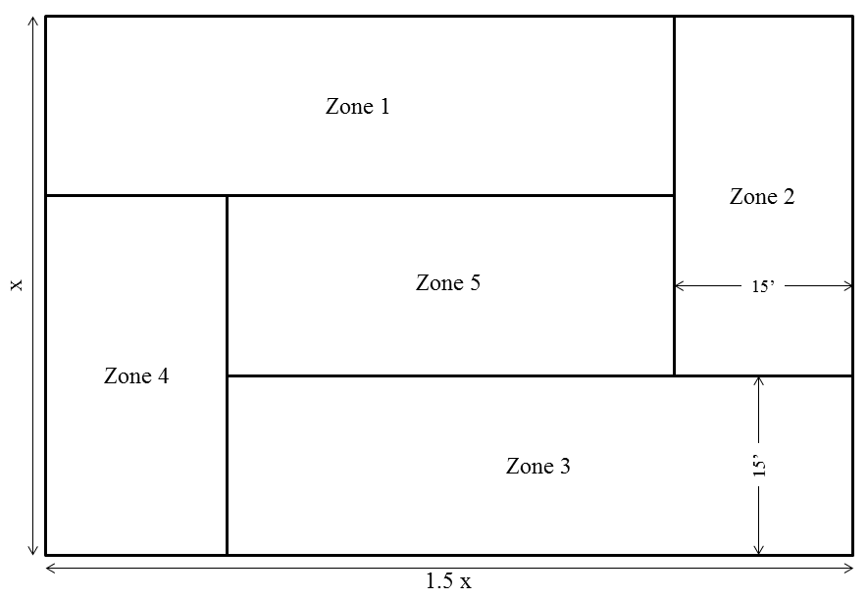
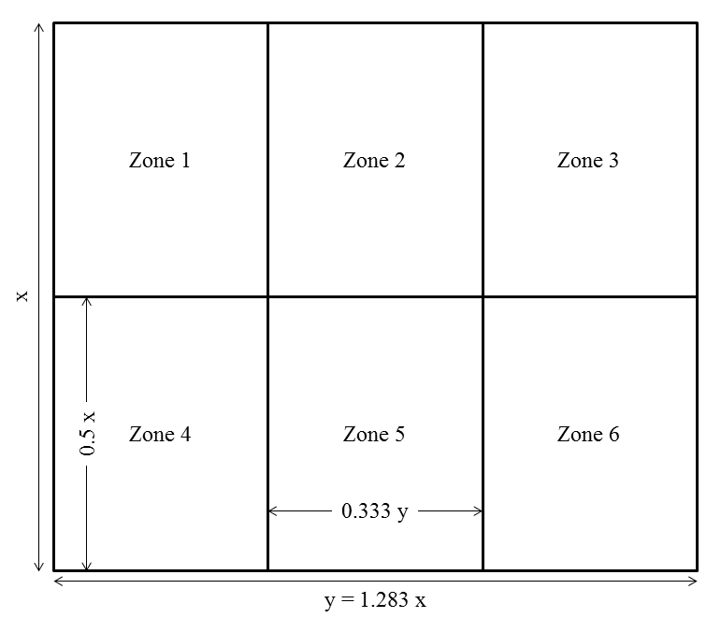
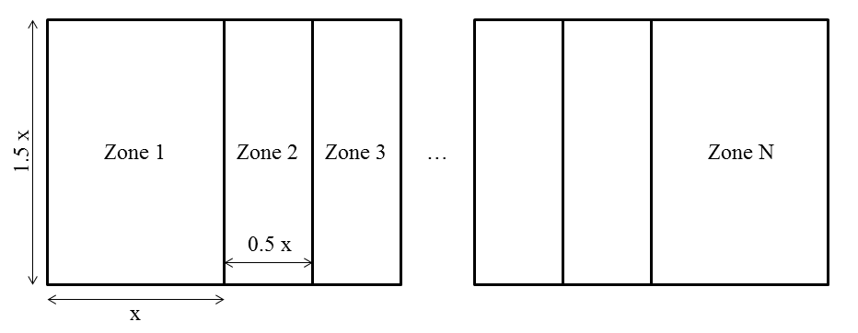
Commercial Loads
Small Office
Big Box
Strip Malls

Slide 26
Commercial Loads (cont.)
Data comes from federal building codes
 | Office | Big Box | Strip Mall
Square Footage | 40,000 +/- 50% | 20,000 +/- 50% | 2400 +/ 30%
Ceiling Height | 13 | 14 | 12
Air Infiltration | 0.69 | 1.5 | 1.76
R Roof | 19 | 19 | 19
R Wall | 18.3 | 18.3 | 18.3
R Floor | 46 | 46 | 40
R Door | 3 | 3 | 3
Glazing Layers | 2 | 2 | 2
Glass Type | Glass | Glass | Glass
Glazing Treatment | Low S | Low S | Low S
Window Frame | None | None | None
No. of Doors | 0 | 0 / 1 / 24 | 1
Window to Wall Ratio | 0 / 0.33 | 0 / 0.76 | 0.03 / 0.05
Internal Gains (W/sf) | 3.24 | 3.6 | 3.6
Cooling COP | 3 +/- 20% | 3 +/- 20% | 3 +/- 20%

Slide 27
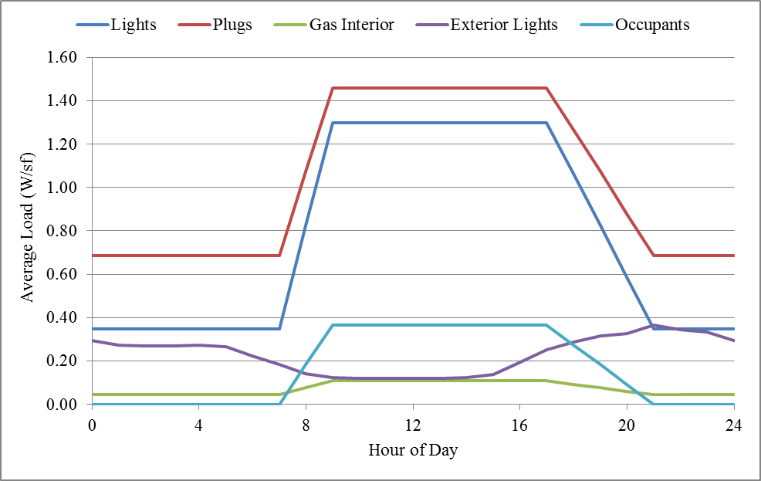
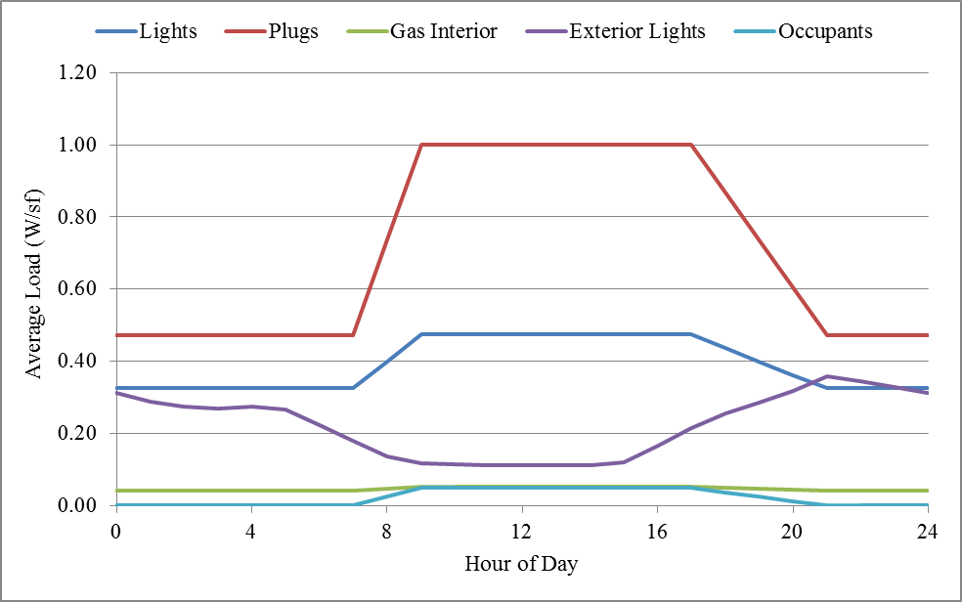
Commercial Loads (cont.)
Load data comes from end use load studies
weekday
weekend

Slide 28
Residential Loads
Loads were broken into 12 classifications
 | R Roof | R Wall | R Floor | Glass Layers | Glass Type | Glazing Treatment | Window Frame | R Door | Air Infiltration | COP High | COP Low
Single Family
Pre-1940 | 16 | 10 | 10 | 1 | Glass | Clear | Alum. | 3 | 0.75 | 2.8 | 2.4
1940-1949 | 19 | 11 | 12 | 2 | Glass | Clear | Alum. | 3 | 0.75 | 3.0 | 2.5
1950-1959 | 19 | 14 | 16 | 2 | Glass | Clear | Alum. | 3 | 0.50 | 3.2 | 2.6
1960-1969 | 30 | 17 | 19 | 2 | Glass | Clear | TB | 3 | 0.50 | 3.4 | 2.8
1970-1979 | 34 | 19 | 20 | 2 | Glass | Clear | TB | 3 | 0.50 | 3.6 | 3.0
1980-1989 | 36 | 22 | 22 | 2 | Low-e | Clear | TB | 5 | 0.25 | 3.8 | 3.0
1990-2005 | 48 | 28 | 30 | 3 | Low-e | Abs. | Ins. | 11 | 0.25 | 4.0 | 3.0
Apartment
Pre-1960 | 13 | 12 | 9 | 1 | Glass | Clear | Alum. | 2 | 0.75 | 2.8 | 1.9
1960-1989 | 20 | 12 | 13 | 2 | Glass | Abs. | TB | 3 | 0.25 | 3.0 | 2.0
1990-2005 | 29 | 14 | 13 | 2 | Low-e | Refl. | Ins. | 6 | 0.13 | 3.2 | 2.1
Mobile Home
1960-1989 | 13 | 9 | 12 | 1 | Glass | Clear | Alum. | 2 | 0.75 | 2.8 | 1.9
1990-2005 | 24 | 12 | 18 | 2 | Low-e | Clear | TB | 3 | 0.75 | 3.5 | 2.2

Slide 29
Residential Loads (cont.)
Penetration levels from EIA website
 | Pre-1940 | 1940-1949 | 1950-1959 | 1960-1969 | 1970-1979 | 1980-1989 | 1990-2005
Region 1 | 8.05 | 7.24 | 10.90 | 8.67 | 13.84 | 12.64 | 12.97
Region 2 | 15.74 | 7.02 | 12.90 | 9.71 | 9.41 | 7.44 | 15.32
Region 3 | 4.48 | 2.52 | 8.83 | 8.43 | 11.85 | 13.15 | 24.11
Region 4 | 5.26 | 3.37 | 8.06 | 8.27 | 10.81 | 12.49 | 25.39
Region 5 | 5.26 | 3.37 | 8.06 | 8.27 | 10.81 | 12.49 | 25.39
HVAC TYPE | Heating Fuel Type |  |  | With Air Conditioner | With Electric Water Heater | With Pool Pump* | One-Story Home*
 | Non-Electric | Heat Pump | Resistance
Region 1 | 70.51 | 3.21 | 26.28 | 43.48 | 25.45 | 9.04 | 68.87
Region 2 | 89.27 | 1.77 | 8.96 | 75.28 | 25.15 | 5.91 | 52.10
Region 3 | 67.23 | 5.59 | 27.18 | 52.59 | 34.80 | 8.18 | 77.45
Region 4 | 44.25 | 19.83 | 35.92 | 96.73 | 64.28 | 6.57 | 70.43
Region 5 | 44.25 | 19.83 | 35.92 | 96.73 | 64.28 | 6.57 | 70.43
AVG SQ FOOTAGE | Single Family | Apartment | Mobile Home
Region 1 | 2209 | 820 | 1054
Region 2 | 2951 | 798 | 1035
Region 3 | 2370 | 764 | 1093
Region 4 | 2655 | 901 | 1069
Region 5 | 2655 | 901 | 1069

Slide 30
Populating Feeders: Physical System

Slide 31
Secondary System Models
Service transformer models (CTTF) typically not included in standard planning models
Use local “rules-of-thumb”, e.g. 5 kVA / customer sizing to get transformer rating
Convert no and full load losses:

Slide 32
Secondary System Models
Add triplex cabling
Random length (10-50 ft.?) triplex cabling added
Sizing, e.g. 1/0 vs. 4/0
Currently uses 1/0 on Residential and 4/0 for small commercial / industrial
Again, use local “rules-of-thumb”
Add triplex-metering (to attach loads)
Can activate billing functions

Slide 33
Populating Feeders: Other

Slide 34
Weather Data
TMY data
Very average data
May be good for long term planning
CSV Reader
Can incorporate “real” data (e.g. 2009)
Required to calibrate to SCADA on a minute-by-minute basis
Requires temperature, humidity, and solar instance
Can sometimes require a fair amount of data processing
May need to be interpolated depending upon simulation goals (ETP model can cause problems)

Slide 35
Populating Feeders: Calibrating to Substation SCADA

Slide 36
Calibrating Load
This has some “black magic” right now
Use a few key parameters as adjustment values to zero-in on actual data
Average size (kW) of residential vs. commercial vs. industrial
Percentage of load as HVAC vs. water heater vs. other end-use loads
How “good” depends on goals
All done via Matlab scripts

